Slide 1
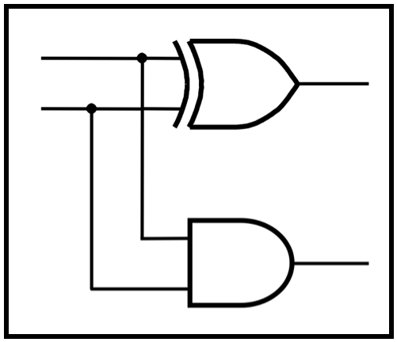
CprE 281:
Digital Logic
Instructor: Alexander Stoytchev
http://www.ece.iastate.edu/~alexs/classes/

Slide 2
Designing a Counter
(Using the Sequential Circuit Approach)
CprE 281: Digital Logic
Iowa State University, Ames, IA
Copyright © Alexander Stoytchev

Slide 3
Example:
Implement a modulo-8 counter

Slide 4
Mini Review

Slide 5
Asynchronous Counters

Slide 6
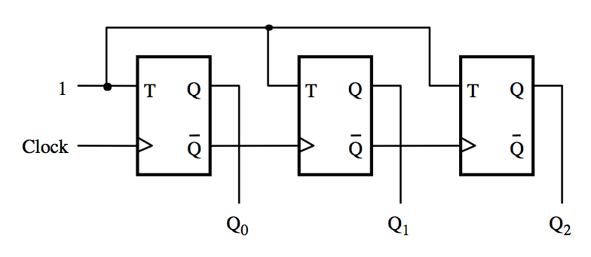
A three-bit up-counter
[ Figure 5.19 from the textbook ]

Slide 7
A three-bit up-counter
The first flip-flop changes
on the positive edge of the clock
[ Figure 5.19 from the textbook ]

Slide 8
A three-bit up-counter
The first flip-flop changes
on the positive edge of the clock
The second flip-flop changes
on the positive edge of Q₀
[ Figure 5.19 from the textbook ]

Slide 9
A three-bit up-counter
The first flip-flop changes
on the positive edge of the clock
The second flip-flop changes
on the positive edge of Q₀
The third flip-flop changes
on the positive edge of Q₁
[ Figure 5.19 from the textbook ]

Slide 10
A three-bit up-counter
1
T
Q
T
Q
T
Q
Clock
Q
Q
Q
Q
Q
Q
0
1
2
(a) Circuit
Clock
Q
0
Q
1
Q
2
Count
0
1
2
3
4
5
6
7
0
(b) Timing diagram
[ Figure 5.19 from the textbook ]

Slide 11
A three-bit up-counter
1
T
Q
T
Q
T
Q
Clock
Q
Q
Q
Q
Q
Q
0
1
2
The propagation delays get longer
(a) Circuit
Clock
Q
0
Q
1
Q
2
Count
0
1
2
3
4
5
6
7
0
(b) Timing diagram
[ Figure 5.19 from the textbook ]

Slide 12
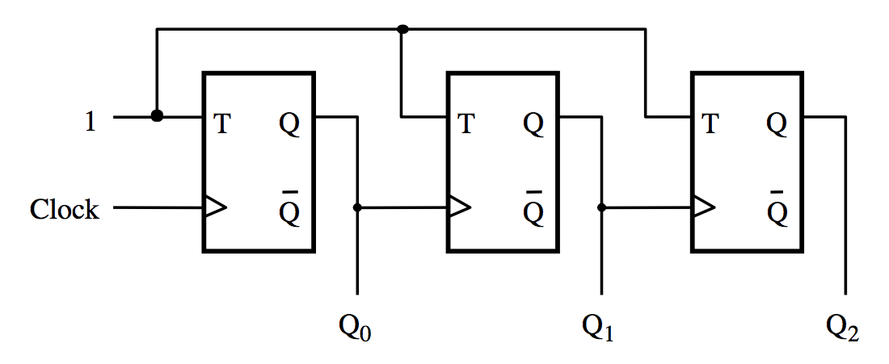
A three-bit down-counter
[ Figure 5.20 from the textbook ]

Slide 13
A three-bit down-counter
1
T
Q
T
Q
T
Q
Clock
Q
Q
Q
Q
Q
Q
0
1
2
(a) Circuit
Clock
Q
0
Q
1
Q
2
Count
0
7
6
5
4
3
2
1
0
(b) Timing diagram
[ Figure 5.20 from the textbook ]

Slide 14
A three-bit down-counter
1
T
Q
T
Q
T
Q
Clock
Q
Q
Q
Q
Q
Q
0
1
2
The propagation delays get longer
(a) Circuit
Clock
Q
0
Q
1
Q
2
Count
0
7
6
5
4
3
2
1
0
(b) Timing diagram
[ Figure 5.20 from the textbook ]

Slide 15
Synchronous Counters

Slide 16
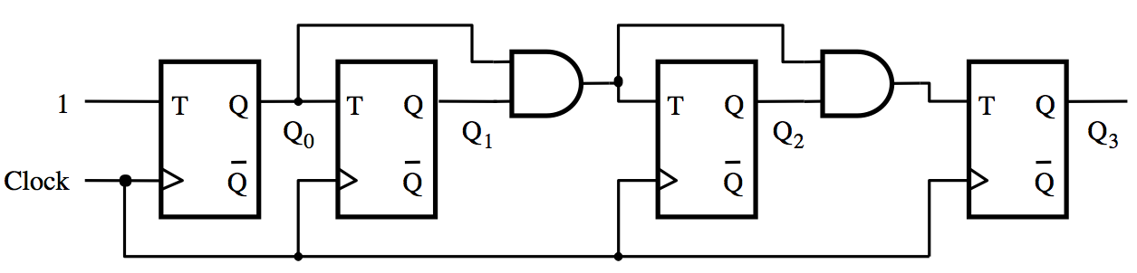
A four-bit synchronous up-counter
[ Figure 5.21 from the textbook ]

Slide 17
A four-bit synchronous up-counter
The propagation delay through all AND gates combined must
not exceed the clock period minus the setup time for the flip-flops
[ Figure 5.21 from the textbook ]

Slide 18
A four-bit synchronous up-counter
1
T
Q
T
Q
T
Q
T
Q
Q
0
Q
1
Q
2
Q
3
Clock
Q
Q
Q
Q
(a) Circuit
Clock
Q
0
Q
1
Q
2
Q
3
Count
0
1
2
3
4
5
6
7
8
9
10
11
12
13
14
15
0
1
(b) Timing diagram
[ Figure 5.21 from the textbook ]

Slide 19
Derivation of the synchronous up-counter
Clock cycle
Q
2
Q
1
Q
0
Q
changes
0
0
0
0
1
Q
changes
1
0
0
1
2
2
0
1
0
3
0
1
1
4
1
0
0
5
1
0
1
6
1
1
0
7
1
1
1
8
0
0
0
[ Table 5.1 from the textbook ]

Slide 20
Derivation of the synchronous up-counter
Clock cycle
Q
2
Q
1
Q
0
Q
changes
0
0
0
0
1
Q
changes
1
0
0
1
2
2
0
1
0
3
0
1
1
4
1
0
0
5
1
0
1
6
1
1
0
7
1
1
1
8
0
0
0
T₀= 1
T₁ = Q₀
T₂ = Q₀ Q₁
[ Table 5.1 from the textbook ]

Slide 21
A four-bit synchronous up-counter
T₀= 1
T₁ = Q₀
T₂ = Q₀ Q₁
[ Figure 5.21 from the textbook ]

Slide 22
In general we have
T₀= 1
T₁ = Q₀
T₂ = Q₀ Q₁
T₃ = Q₀ Q₁ Q₂
…
T_{n} = Q₀ Q₁ Q₂ …Q_{n-1}

Slide 23
Inclusion of Enable and Clear capability
Enable
T
Q
T
Q
T
Q
T
Q
Clock
Q
Q
Q
Q
Clear_n
[ Figure 5.22 from the textbook ]

Slide 24
Inclusion of Enable and Clear capability
This is the new thing relative to
the previous figure, plus the clear_n line
Enable
T
Q
T
Q
T
Q
T
Q
Clock
Q
Q
Q
Q
Clear_n
[ Figure 5.22 from the textbook ]

Slide 25
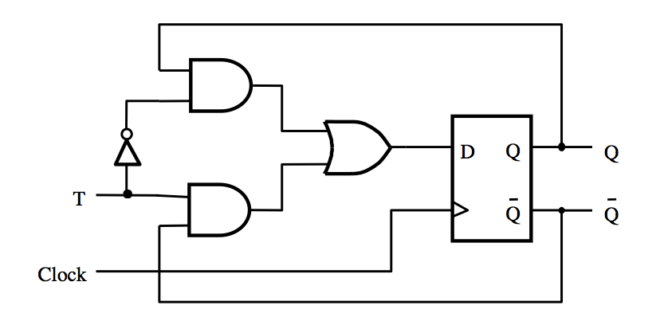
T Flip-Flop
[ Figure 5.15a from the textbook ]

Slide 26
T Flip-Flop
Positive-edge-triggered
D Flip-Flop
[ Figure 5.15a from the textbook ]

Slide 27
T Flip-Flop
2-to-1 multiplexer
[ Figure 5.15a from the textbook ]

Slide 28
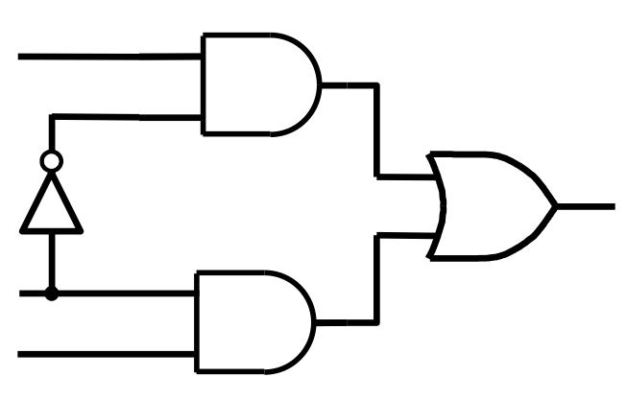
2-to-1 Multiplexer
Q
D
T
Q

Slide 29
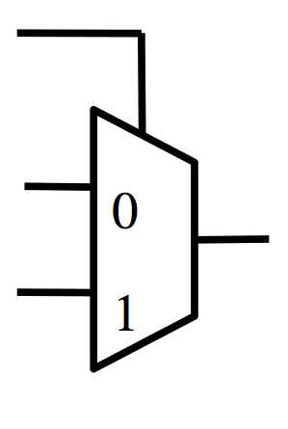
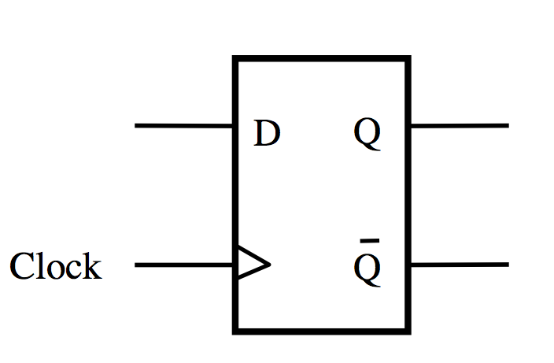
What is this?
T
Q
+
= ?
D
Q

Slide 30
T Flip-Flop
T
0
D
Q
1
Clock
Q

Slide 31
T Flip-Flop
D
Q
Q
T
Q
Q
Clock

Slide 32
T Flip-Flop
D
Q
Q
T
Q
Q
Clock

Slide 33
T Flip-Flop
D
Q
Q
T
Q
Q
Clock

Slide 34
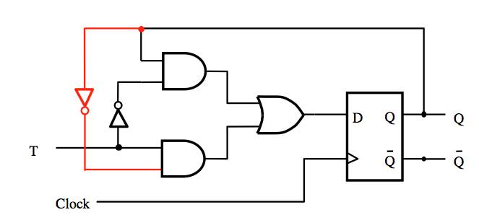
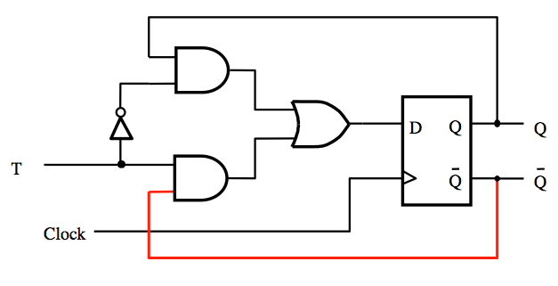
These two circuits are equivalent

Slide 35

What is this?
Q
D
T

Slide 36
What is this?
Q
D
T
D = QT + QT

Slide 37
What is this?
Q
D
T
D = Q + T

Slide 38
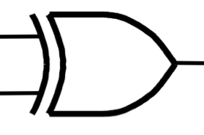
What is this?
Q
D
T
D = Q + T

Slide 39
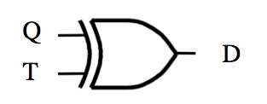
What is this?
+
= ?

Slide 40
T Flip-Flop
T
D
Q
Clock
Q

Slide 41
Synchronous Counter with D Flip-Flops

Slide 42
A three-bit up-counter with T flip-flops
Enable
T
Q
T
Q
T
Q
Clock
Q
Q
Q

Slide 43
A three-bit up-counter with D flip-flops
T
D
Q
Clock
Q
T
D
Q
Clock
Q
T
D
Q
Clock
Q

Slide 44
A three-bit up-counter with D flip-flops
Enable
T
D
Q
Clock
Q
T
D
Q
Clock
Q
T
D
Q
Clock
Q

Slide 45
A three-bit up-counter with D flip-flops
Enable
T
D
Q
Q
T
D
Q
Q
T
D
Q
Q
Clock

Slide 46
A four-bit up-counter with T flip-flops
Enable
T
Q
T
Q
T
Q
T
Q
Clock
Q
Q
Q
Q
[ Figure 5.22 from the textbook (Modified) ]

Slide 47
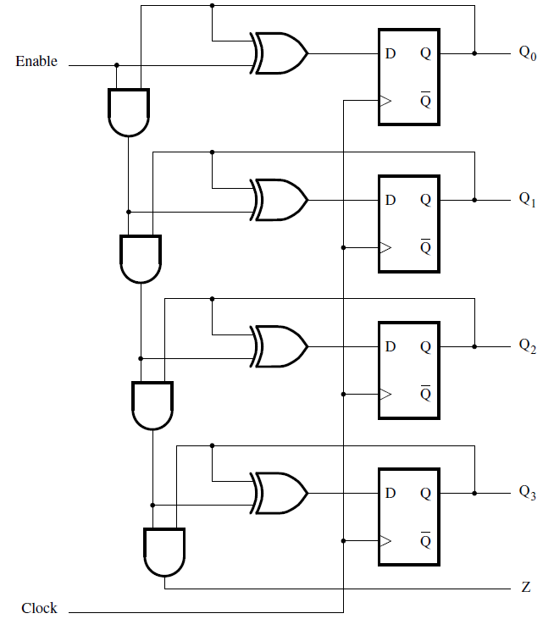
A four-bit up-counter with D flip-flops
[ Figure 5.23 from the textbook ]

Slide 48
End of Mini Review

Slide 49
Goal
Implement a modulo-8 counter using the sequential circuit approach
In other words, the counting sequence must be
0, 1, 2, 3, 4, 5, 6, 7, 0, 1, 2, …
The count changes based on the input signal w:
  If w=0, then the count remains the same
  If w=1, then the count is advanced by one

Slide 50
State diagram for the counter
w
=
0
w
=
0
w
=
0
w
=
0
w
=
1
w
=
1
w
=
1
A/0
B/1
C/2
D/3
w
=
1
w
=
1
H/7
G/6
F/5
E/4
w
=
1
w
=
1
w
=
1
w
=
0
w
=
0
w
=
0
w
=
0
[ Figure 6.60 from the textbook ]

Slide 51
State table for the counter
Present
Next state
Output
state
w
=
0
w
=
1
A
A
B
0
B
B
C
1
C
C
D
2
D
D
E
3
E
E
F
4
F
F
G
5
G
G
H
6
H
H
A
7
[ Figure 6.61 from the textbook ]

Slide 52
State-assigned table for the counter
Next state
Present
Count
state
w
=
0
w
=
1
y
2
y
1
y
0
z
2
z
1
z
0
Y
2
Y
1
Y
0
Y
2
Y
1
Y
0
A
000
000
001
000
B
001
001
010
001
C
010
010
011
010
D
011
011
100
011
E
100
100
101
100
F
101
101
110
101
G
110
110
111
110
H
111
111
000
111
[ Figure 6.62 from the textbook ]

Slide 53
K-map for Y₀
Next state
Present
Count
y
y
state
w
=
0
w
=
1
1
0
y
y
y
z
z
z
wy
2
2
1
0
Y
Y
Y
Y
Y
Y
2
1
0
00
01
11
10
2
1
0
2
1
0
00
A
000
000
001
000
B
001
001
010
001
01
C
010
010
011
010
11
D
011
011
100
011
10
E
100
100
101
100
F
101
101
110
101
G
110
110
111
110
H
111
111
000
111

Slide 54
K-map for Y₀
Next state
Present
Count
y
y
state
w
=
0
w
=
1
1
0
y
y
y
z
z
z
wy
2
2
1
0
Y
Y
Y
Y
Y
Y
2
1
0
00
01
11
10
2
1
0
2
1
0
00
A
000
000
001
000
B
001
001
010
001
01
C
010
010
011
010
11
D
011
011
100
011
10
E
100
100
101
100
F
101
101
110
101
G
110
110
111
110
H
111
111
000
111

Slide 55
K-map for Y₀
Next state
Present
Count
y
y
state
w
=
0
w
=
1
1
0
y
y
y
z
z
z
wy
2
2
1
0
Y
Y
Y
Y
Y
Y
2
1
0
00
01
11
10
2
1
0
2
1
0
00
0
1
1
0
A
000
000
001
000
B
001
001
010
001
01
0
1
1
0
C
010
010
011
010
11
1
0
0
1
D
011
011
100
011
10
1
0
0
1
E
100
100
101
100
F
101
101
110
101
G
110
110
111
110
H
111
111
000
111

Slide 56
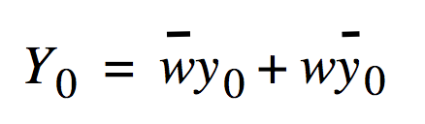
K-map for Y₀
Next state
Present
Count
y
y
state
w
=
0
w
=
1
1
0
y
y
y
z
z
z
wy
2
2
1
0
Y
Y
Y
Y
Y
Y
2
1
0
00
01
11
10
2
1
0
2
1
0
00
0
1
1
0
A
000
000
001
000
B
001
001
010
001
01
0
1
1
0
C
010
010
011
010
11
1
0
0
1
D
011
011
100
011
10
1
0
0
1
E
100
100
101
100
F
101
101
110
101
Y
0
=
wy
0
+
wy
0
G
110
110
111
110
H
111
111
000
111

Slide 57
K-map for Y₁
Next state
Present
Count
y
y
state
w
=
0
w
=
1
1
0
y
y
y
z
z
z
wy
2
2
1
0
Y
Y
Y
Y
Y
Y
2
1
0
00
01
11
10
2
1
0
2
1
0
00
A
000
000
001
000
B
001
001
010
001
01
C
010
010
011
010
11
D
011
011
100
011
10
E
100
100
101
100
F
101
101
110
101
G
110
110
111
110
H
111
111
000
111

Slide 58
K-map for Y₁
Next state
Present
Count
y
y
state
w
=
0
w
=
1
1
0
y
y
y
z
z
z
wy
2
2
1
0
Y
Y
Y
Y
Y
Y
2
1
0
00
01
11
10
2
1
0
2
1
0
00
A
000
000
001
000
B
001
001
010
001
01
C
010
010
011
010
11
D
011
011
100
011
10
E
100
100
101
100
F
101
101
110
101
G
110
110
111
110
H
111
111
000
111

Slide 59
K-map for Y₁
Next state
Present
Count
y
y
state
w
=
0
w
=
1
1
0
y
y
y
z
z
z
wy
2
2
1
0
Y
Y
Y
Y
Y
Y
2
1
0
00
01
11
10
2
1
0
2
1
0
00
0
0
1
1
A
000
000
001
000
B
001
001
010
001
01
0
0
1
1
C
010
010
011
010
11
0
1
0
1
D
011
011
100
011
10
0
1
0
1
E
100
100
101
100
F
101
101
110
101
G
110
110
111
110
H
111
111
000
111

Slide 60
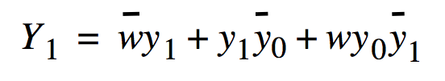
K-map for Y₁
Next state
Present
Count
y
y
state
w
=
0
w
=
1
1
0
y
y
y
z
z
z
wy
2
2
1
0
Y
Y
Y
Y
Y
Y
2
1
0
00
01
11
10
2
1
0
2
1
0
00
0
0
1
1
A
000
000
001
000
B
001
001
010
001
01
0
0
1
1
C
010
010
011
010
11
0
1
0
1
D
011
011
100
011
10
0
1
0
1
E
100
100
101
100
F
101
101
110
101
Y
1
=
wy
1
+
y
1
y
0
+
wy
0
y
1
G
110
110
111
110
H
111
111
000
111

Slide 61
K-map for Y₂
Next state
Present
Count
y
y
state
w
=
0
w
=
1
1
0
y
y
y
z
z
z
wy
2
2
1
0
Y
Y
Y
Y
Y
Y
2
1
0
00
01
11
10
2
1
0
2
1
0
00
A
000
000
001
000
B
001
001
010
001
01
C
010
010
011
010
11
D
011
011
100
011
10
E
100
100
101
100
F
101
101
110
101
G
110
110
111
110
H
111
111
000
111

Slide 62
K-map for Y₂
Next state
Present
Count
y
y
state
w
=
0
w
=
1
1
0
y
y
y
z
z
z
wy
2
2
1
0
Y
Y
Y
Y
Y
Y
2
1
0
00
01
11
10
2
1
0
2
1
0
00
A
000
000
001
000
B
001
001
010
001
01
C
010
010
011
010
11
D
011
011
100
011
10
E
100
100
101
100
F
101
101
110
101
G
110
110
111
110
H
111
111
000
111

Slide 63
K-map for Y₂
Next state
Present
Count
y
y
state
w
=
0
w
=
1
1
0
y
y
y
z
z
z
wy
2
2
1
0
Y
Y
Y
Y
Y
Y
2
1
0
00
01
11
10
2
1
0
2
1
0
00
0
0
0
0
A
000
000
001
000
B
001
001
010
001
01
1
1
1
1
C
010
010
011
010
11
1
1
0
1
D
011
011
100
011
10
0
0
1
0
E
100
100
101
100
F
101
101
110
101
G
110
110
111
110
H
111
111
000
111

Slide 64

K-map for Y₂
Next state
Present
Count
y
y
state
w
=
0
w
=
1
1
0
y
y
y
z
z
z
wy
2
2
1
0
Y
Y
Y
Y
Y
Y
2
1
0
00
01
11
10
2
1
0
2
1
0
00
0
0
0
0
A
000
000
001
000
B
001
001
010
001
01
1
1
1
1
C
010
010
011
010
11
1
1
0
1
D
011
011
100
011
10
0
0
1
0
E
100
100
101
100
F
101
101
110
101
G
110
110
111
110
H
111
111
000
111

Slide 65
Karnaugh maps for D flip-flops for the counter
y
1
y
0
y
1
y
0
wy
2
wy
2
00
01
11
10
00
01
11
10
00
0
1
1
0
00
0
0
1
1
01
0
1
1
0
01
0
0
1
1
11
1
0
0
1
11
0
1
0
1
10
1
0
0
1
10
0
1
0
1
Y
0
=
wy
0
+
wy
0
Y
1
=
wy
1
+
y
1
y
0
+
wy
0
y
1
y
1
y
0
wy
2
00
01
11
10
00
0
0
0
0
01
1
1
1
1
11
1
1
0
1
10
0
0
1
0
Y
2
=
wy
2
+
y
0
y
2
+
y
1
y
2
+
w
y
0
y
1
y
2
[ Figure 6.63 from the textbook ]

Slide 66
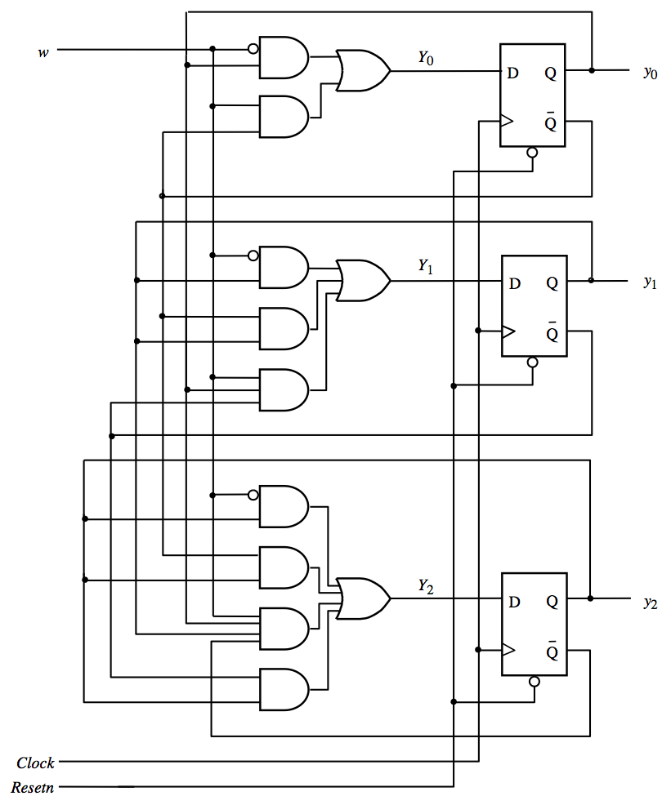
Circuit diagram
for the counter
implemented
with D flip-flops
[ Figure 6.64 from the textbook ]

Slide 67
Circuit diagram
for the counter
implemented
with D flip-flops
What is this?
[ Figure 6.64 from the textbook ]

Slide 68
Circuit diagram
for the counter
implemented
with D flip-flops
XOR
[ Figure 6.64 from the textbook ]

Slide 69
We can simplify all three expressions

Slide 70

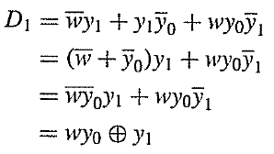
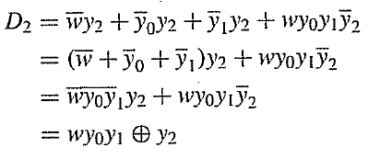
We can simplify all three expressions

Slide 71
A three-bit counter with D flip-flops
Enable
T
D
Q
Q
T
D
Q
Q
T
D
Q
Q
Clock

Slide 72
A four-bit counter with D flip-flops
[ Figure 5.23 from the textbook ]

Slide 73
Summary
The up-counters that we studied in Chapter 5 can now be derived using the sequential circuit approach
We get the same circuit diagrams as before

Slide 74
Example 2:
Implement a modulo-8 counter using JK Flip-Flops

Slide 75
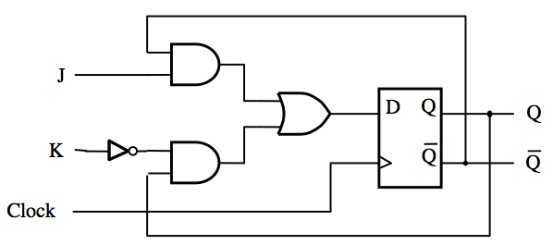
JK Flip-Flop
D = JQ + KQ
[ Figure 5.16a from the textbook ]

Slide 76
JK Flip-Flop
J
D
Q
Q
K
Q
Q
Clock
(a) Circuit
J
K
Q
(
t
+
1
)
0
0
Q
(
t
)
J
Q
0
1
0
1
0
1
K
Q
1
1
Q
(
t
)
(b) Truth table
(c) Graphical symbol
[ Figure 5.16 from the textbook ]

Slide 77
JK Flip-Flop
(How it Works)
A versatile circuit that can be used both as a SR flip-flop and as a T flip flop
If J=0 and K =0 it stays in the same state
Just like SR It can be set and reset
J=S and K=R
If J=K then it behaves as a T flip-flop

Slide 78
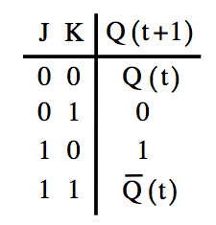
Transition Rules in terms of J and K
Current State
of the Flip-flop: Q(t)
Next State
of the Flip-flop: Q(t+1)
From 0 to 0 J=0 and K= d
From 0 to 1 J=1 and K= d
From 1 to 0 J=d and K= 1
From 1 to 1 J=d and K= 0

Slide 79
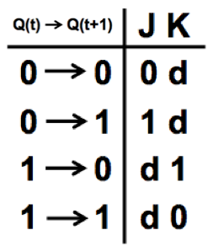
Transition Rules in terms of J and K
Current State
of the Flip-flop: Q(t)
Next State
of the Flip-flop: Q(t+1)
From 0 to 0 J=0 and K= d
From 0 to 1 J=1 and K= d
From 1 to 0 J=d and K= 1
From 1 to 1 J=d and K= 0

Slide 80
Excitation table for the counter with JK flip-flops
Present
Flip-flop inputs
state
w
=
0
w
=
1
Count
y
2
y
1
y
0
z
2
z
1
z
0
Y
2
Y
1
Y
0
J
2
K
2
J
1
K
1
J
0
K
0
Y
2
Y
1
Y
0
J
2
K
2
J
1
K
1
J
0
K
0
A
000
000
0d
0d
0d
001
0d
0d
1d
000
B
001
001
0d
0d
d0
010
0d
1d
d1
001
C
010
010
0d
d0
0d
011
0d
d0
1d
010
D
011
011
0d
d0
d0
100
1d
d1
d1
011
E
100
100
d0
0d
0d
101
d0
0d
1d
100
F
101
101
d0
0d
d0
110
d0
1d
d1
101
G
110
110
d0
d0
0d
111
d0
d0
1d
110
H
111
111
d0
d0
d0
000
d1
d1
d1
111
[ Figure 6.65 from the textbook ]

Slide 81
Excitation table for the counter with JK flip-flops
Present
Flip-flop inputs
state
w
=
0
w
=
1
Count
y
2
y
1
y
0
z
2
z
1
z
0
Y
2
Y
1
Y
0
J
2
K
2
J
1
K
1
J
0
K
0
Y
2
Y
1
Y
0
J
2
K
2
J
1
K
1
J
0
K
0
A
000
000
0d
0d
0d
001
0d
0d
1d
000
B
001
001
0d
0d
d0
010
0d
1d
d1
001
C
010
010
0d
d0
0d
011
0d
d0
1d
010
D
011
011
0d
d0
d0
100
1d
d1
d1
011
E
100
100
d0
0d
0d
101
d0
0d
1d
100
F
101
101
d0
0d
d0
110
d0
1d
d1
101
G
110
110
d0
d0
0d
111
d0
d0
1d
110
H
111
111
d0
d0
d0
000
d1
d1
d1
111
[ Figure 6.65 from the textbook ]

Slide 82
Karnaugh maps for the first JK flip-flop
Present
Flip-flop inputs
state
w
=
0
w
=
1
Count
y
2
y
1
y
0
z
2
z
1
z
0
Y
2
Y
1
Y
0
J
2
K
2
J
1
K
1
J
0
K
0
Y
2
Y
1
Y
0
J
2
K
2
J
1
K
1
J
0
K
0
A
000
000
0d
0d
0d
001
0d
0d
1d
000
B
001
001
0d
0d
d0
010
0d
1d
d1
001
C
010
010
0d
d0
0d
011
0d
d0
1d
010
D
011
011
0d
d0
d0
100
1d
d1
d1
011
E
100
100
d0
0d
0d
101
d0
0d
1d
100
F
101
101
d0
0d
d0
110
d0
1d
d1
101
G
110
110
d0
d0
0d
111
d0
d0
1d
110
H
111
111
d0
d0
d0
000
d1
d1
d1
111
y
1
y
0
y
1
y
0
wy
2
00
01
11
10
wy
2
00
01
11
10
00
00
01
01
11
11
10
10

Slide 83
Karnaugh maps for the first JK flip-flop
Present
Flip-flop inputs
state
w
=
0
w
=
1
Count
y
2
y
1
y
0
z
2
z
1
z
0
Y
2
Y
1
Y
0
J
2
K
2
J
1
K
1
J
0
K
0
Y
2
Y
1
Y
0
J
2
K
2
J
1
K
1
J
0
K
0
A
000
000
0d
0d
0d
001
0d
0d
1d
000
B
001
001
0d
0d
d0
010
0d
1d
d1
001
C
010
010
0d
d0
0d
011
0d
d0
1d
010
D
011
011
0d
d0
d0
100
1d
d1
d1
011
E
100
100
d0
0d
0d
101
d0
0d
1d
100
F
101
101
d0
0d
d0
110
d0
1d
d1
101
G
110
110
d0
d0
0d
111
d0
d0
1d
110
H
111
111
d0
d0
d0
000
d1
d1
d1
111
y
1
y
0
y
1
y
0
wy
2
00
01
11
10
wy
2
00
01
11
10
00
00
J₀
01
01
K₀
11
11
10
10

Slide 84
Karnaugh maps for the first JK flip-flop
Present
Flip-flop inputs
state
w
=
0
w
=
1
Count
y
2
y
1
y
0
z
2
z
1
z
0
Y
2
Y
1
Y
0
J
2
K
2
J
1
K
1
J
0
K
0
Y
2
Y
1
Y
0
J
2
K
2
J
1
K
1
J
0
K
0
A
000
000
0d
0d
0d
001
0d
0d
1d
000
B
001
001
0d
0d
d0
010
0d
1d
d1
001
C
010
010
0d
d0
0d
011
0d
d0
1d
010
D
011
011
0d
d0
d0
100
1d
d1
d1
011
E
100
100
d0
0d
0d
101
d0
0d
1d
100
F
101
101
d0
0d
d0
110
d0
1d
d1
101
G
110
110
d0
d0
0d
111
d0
d0
1d
110
H
111
111
d0
d0
d0
000
d1
d1
d1
111
y
1
y
0
y
1
y
0
wy
2
00
01
11
10
wy
2
00
01
11
10
00
00
J₀
01
01
K₀
11
11
10
10

Slide 85
Karnaugh maps for the first JK flip-flop
Present
Flip-flop inputs
state
w
=
0
w
=
1
Count
y
2
y
1
y
0
z
2
z
1
z
0
Y
2
Y
1
Y
0
J
2
K
2
J
1
K
1
J
0
K
0
Y
2
Y
1
Y
0
J
2
K
2
J
1
K
1
J
0
K
0
A
000
000
0d
0d
0d
001
0d
0d
1d
000
B
001
001
0d
0d
d0
010
0d
1d
d1
001
C
010
010
0d
d0
0d
011
0d
d0
1d
010
D
011
011
0d
d0
d0
100
1d
d1
d1
011
E
100
100
d0
0d
0d
101
d0
0d
1d
100
F
101
101
d0
0d
d0
110
d0
1d
d1
101
G
110
110
d0
d0
0d
111
d0
d0
1d
110
H
111
111
d0
d0
d0
000
d1
d1
d1
111
y
1
y
0
y
1
y
0
wy
2
00
01
11
10
wy
2
00
01
11
10
00
0
d
d
0
00
J₀
01
0
d
d
0
01
K₀
11
1
d
d
1
11
10
1
d
d
1
10

Slide 86
Karnaugh maps for the first JK flip-flop
Present
Flip-flop inputs
state
w
=
0
w
=
1
Count
y
2
y
1
y
0
z
2
z
1
z
0
Y
2
Y
1
Y
0
J
2
K
2
J
1
K
1
J
0
K
0
Y
2
Y
1
Y
0
J
2
K
2
J
1
K
1
J
0
K
0
A
000
000
0d
0d
0d
001
0d
0d
1d
000
B
001
001
0d
0d
d0
010
0d
1d
d1
001
C
010
010
0d
d0
0d
011
0d
d0
1d
010
D
011
011
0d
d0
d0
100
1d
d1
d1
011
E
100
100
d0
0d
0d
101
d0
0d
1d
100
F
101
101
d0
0d
d0
110
d0
1d
d1
101
G
110
110
d0
d0
0d
111
d0
d0
1d
110
H
111
111
d0
d0
d0
000
d1
d1
d1
111
y
1
y
0
y
1
y
0
wy
2
00
01
11
10
wy
2
00
01
11
10
00
0
d
d
0
00
d
0
0
d
J₀
01
0
d
d
0
01
d
0
0
d
K₀
11
1
d
d
1
11
d
1
1
d
10
1
d
d
1
10
d
1
1
d

Slide 87
Karnaugh maps for the first JK flip-flop
Present
Flip-flop inputs
state
w
=
0
w
=
1
Count
y
2
y
1
y
0
z
2
z
1
z
0
Y
2
Y
1
Y
0
J
2
K
2
J
1
K
1
J
0
K
0
Y
2
Y
1
Y
0
J
2
K
2
J
1
K
1
J
0
K
0
A
000
000
0d
0d
0d
001
0d
0d
1d
000
B
001
001
0d
0d
d0
010
0d
1d
d1
001
C
010
010
0d
d0
0d
011
0d
d0
1d
010
D
011
011
0d
d0
d0
100
1d
d1
d1
011
E
100
100
d0
0d
0d
101
d0
0d
1d
100
F
101
101
d0
0d
d0
110
d0
1d
d1
101
G
110
110
d0
d0
0d
111
d0
d0
1d
110
H
111
111
d0
d0
d0
000
d1
d1
d1
111
y
1
y
0
y
1
y
0
wy
2
00
01
11
10
wy
2
00
01
11
10
00
0
d
d
0
00
d
0
0
d
J₀
01
0
d
d
0
01
d
0
0
d
K₀
11
1
d
d
1
11
d
1
1
d
10
1
d
d
1
10
d
1
1
d

Slide 88
Karnaugh maps for the first JK flip-flop
Present
Flip-flop inputs
state
w
=
0
w
=
1
Count
y
2
y
1
y
0
z
2
z
1
z
0
Y
2
Y
1
Y
0
J
2
K
2
J
1
K
1
J
0
K
0
Y
2
Y
1
Y
0
J
2
K
2
J
1
K
1
J
0
K
0
A
000
000
0d
0d
0d
001
0d
0d
1d
000
B
001
001
0d
0d
d0
010
0d
1d
d1
001
C
010
010
0d
d0
0d
011
0d
d0
1d
010
D
011
011
0d
d0
d0
100
1d
d1
d1
011
E
100
100
d0
0d
0d
101
d0
0d
1d
100
F
101
101
d0
0d
d0
110
d0
1d
d1
101
G
110
110
d0
d0
0d
111
d0
d0
1d
110
H
111
111
d0
d0
d0
000
d1
d1
d1
111
y
1
y
0
y
1
y
0
wy
2
00
01
11
10
wy
2
00
01
11
10
00
0
d
d
0
00
d
0
0
d
J₀
01
0
d
d
0
01
d
0
0
d
K₀
11
1
d
d
1
11
d
1
1
d
10
1
d
d
1
10
d
1
1
d
J
0
=
w
K
0
=
w

Slide 89
Karnaugh maps for the first JK flip-flop
y
1
y
0
y
1
y
0
wy
2
00
01
11
10
wy
2
00
01
11
10
00
0
d
d
0
00
d
0
0
d
J₀
01
0
d
d
0
01
d
0
0
d
K₀
11
1
d
d
1
11
d
1
1
d
10
1
d
d
1
10
d
1
1
d
J
0
=
w
K
0
=
w
[ Figure 6.66 from the textbook ]

Slide 90
Karnaugh maps for the second JK flip-flop
y
1
y
0
y
1
y
0
wy
2
00
01
11
10
wy
2
00
01
11
10
00
0
0
d
d
00
d
d
0
0
J₁
01
0
0
d
d
01
d
d
0
0
K₁
11
0
1
d
d
11
d
d
1
0
10
0
1
d
d
10
d
d
1
0
J
1
=
wy
0
K
1
=
wy
0
[ Figure 6.66 from the textbook ]

Slide 91
Karnaugh maps for the third JK flip-flop
y
1
y
0
y
1
y
0
wy
2
00
01
11
10
wy
2
00
01
11
10
00
0
0
0
0
00
d
d
d
d
J₂
01
d
d
d
d
01
0
0
0
0
K₂
11
d
d
d
d
11
0
0
1
0
10
0
0
1
0
10
d
d
d
d
J
2
=
wy
0
y
1
K
2
=
wy
0
y
1
[ Figure 6.66 from the textbook ]

Slide 92

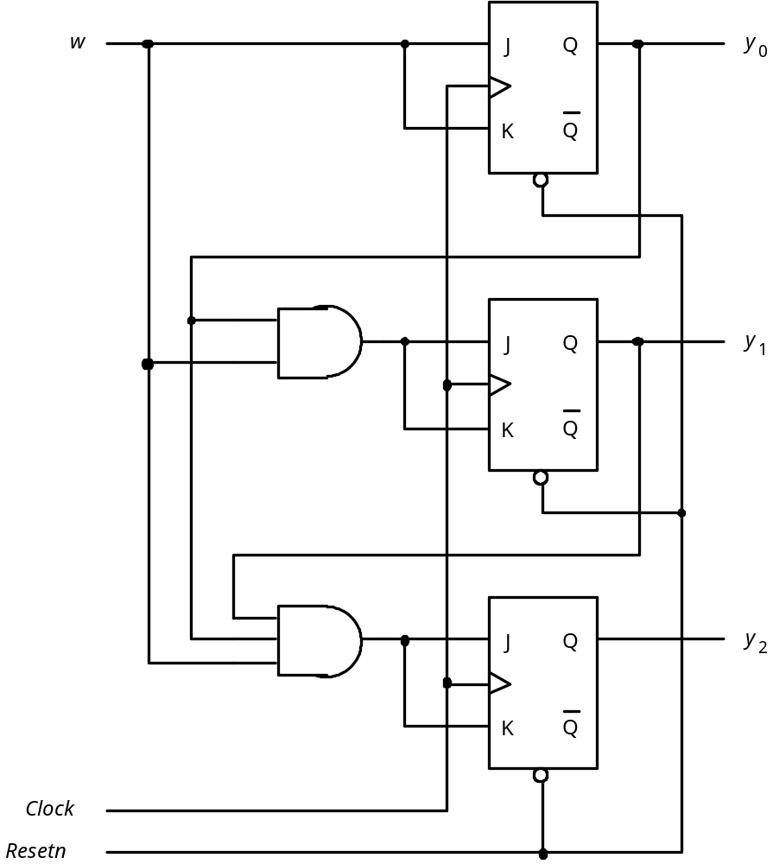





Circuit diagram using JK flip-flops

Slide 93
Circuit diagram using JK flip-flops
[ Figure 6.67 from the textbook ]

Slide 94
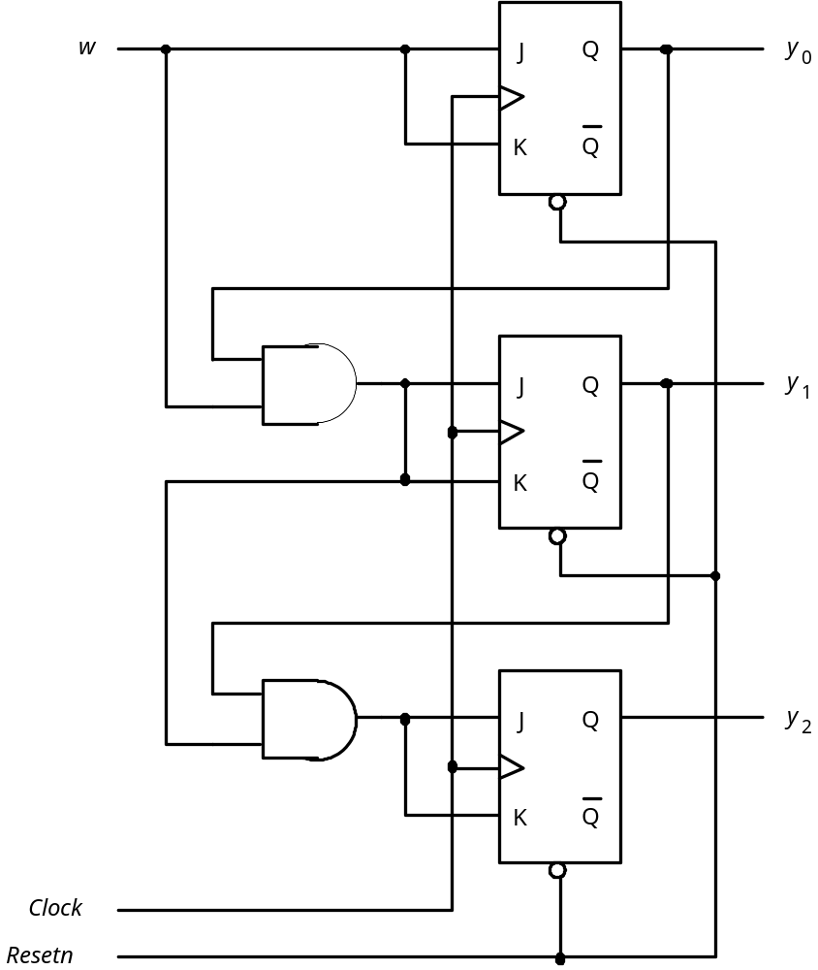
Factored-form implementation of the counter
[ Figure 6.68 from the textbook ]

Slide 95
Another Example
(A Different “Counter”)

Slide 96
Goal
Implement a 3-bit counter using the sequential circuit approach that counts the pulses on the input line w.
The counter must count in the following sequence:
0, 4, 2, 6, 1, 5, 3, 7, 0, 4, 2, …
The count must be represented directly by the flip-flop values. No extra gates are allowed.
In other words, count = Q₂ Q₁ Q₀
The count changes based on the input signal w:
  If w=0, then the count remains the same
  If w=1, then the count is advanced by one

Slide 97
Goal
Implement a 3-bit counter using the sequential circuit approach that counts the pulses on the input line w.
The counter must count in the following sequence:
0, 4, 2, 6, 1, 5, 3, 7, 0, 4, 2, …
The count must be represented directly by the flip-flop values. No extra gates are allowed.
In other words, count = Q₂ Q₁ Q₀
The count changes based on the input signal w:
  If w=0, then the count remains the same
  If w=1, then the count is advanced by one
Clock = w

Slide 98
By flipping the order of the bits we get
000
001
010
011
100
101
110
111
000
100
010
110
001
101
011
111

Slide 99
By flipping the order of the bits we get
0
1
2
3
4
5
6
7
000
001
010
011
100
101
110
111
000
100
010
110
001
101
011
111
0
4
2
6
1
5
3
7

Slide 100
State table for the counterlike example
Present
Next
Output
state
state
z
2
z
1
z
0
A
B
000
B
C
100
C
D
010
D
E
110
E
F
001
F
G
101
G
H
011
H
A
111
[ Figure 6.69 from the textbook ]

Slide 101
State-assigned table for this example
Present
Next
Output
state
state
y
2
y
1
y
0
Y
2
Y
1
Y
0
z
2
z
1
z
0
000
1
00
0
00
100
0
10
1
00
010
1
10
0
10
110
0
01
1
10
001
1
01
0
01
101
0
11
1
01
011
1
11
0
11
111
0
00
1
11
[ Figure 6.70 from the textbook ]

Slide 102
K-maps for Y₂, Y₁, and Y₀
Present
Next
Output
state
state
y
y
y
Y
Y
Y
z
z
z
y
1
y
0
2
1
0
2
1
0
2
1
0
y
000
1
00
0
00
2
00
01
11
10
100
0
10
1
00
0
010
1
10
0
10
110
0
01
1
10
1
001
1
01
0
01
101
0
11
1
01
011
1
11
0
11
111
0
00
1
11

Slide 103
K-maps for Y₂, Y₁, and Y₀
Present
Next
Output
state
state
y
y
y
Y
Y
Y
z
z
z
y
1
y
0
2
1
0
2
1
0
2
1
0
y
000
1
00
0
00
2
00
01
11
10
100
0
10
1
00
0
010
1
10
0
10
110
0
01
1
10
1
001
1
01
0
01
101
0
11
1
01
011
1
11
0
11
111
0
00
1
11
Notice that these
are scrambled

Slide 104
K-maps for Y₂, Y₁, and Y₀
Present
Next
Output
state
state
y
y
y
Y
Y
Y
z
z
z
y
1
y
0
2
1
0
2
1
0
2
1
0
y
000
1
00
0
00
2
00
01
11
10
100
0
10
1
00
0
010
1
10
0
10
110
0
01
1
10
1
001
1
01
0
01
101
0
11
1
01
011
1
11
0
11
111
0
00
1
11
Notice that these
are scrambled

Slide 105
K-map for Y₂
Present
Next
Output
state
state
y
y
y
Y
Y
Y
z
z
z
y
1
y
0
2
1
0
2
1
0
2
1
0
y
000
1
00
0
00
2
00
01
11
10
100
0
10
1
00
0
010
1
10
0
10
110
0
01
1
10
1
001
1
01
0
01
101
0
11
1
01
011
1
11
0
11
111
0
00
1
11

Slide 106
K-map for Y₂
Present
Next
Output
state
state
y
y
y
Y
Y
Y
z
z
z
y
1
y
0
2
1
0
2
1
0
2
1
0
y
000
1
00
0
00
2
00
01
11
10
100
0
10
1
00
0
010
1
10
0
10
110
0
01
1
10
1
001
1
01
0
01
101
0
11
1
01
011
1
11
0
11
111
0
00
1
11

Slide 107
K-map for Y₂
Present
Next
Output
state
state
y
y
y
Y
Y
Y
z
z
z
y
1
y
0
2
1
0
2
1
0
2
1
0
y
000
1
00
0
00
2
00
01
11
10
100
0
10
1
00
0
1
1
1
1
010
1
10
0
10
110
0
01
1
10
1
0
0
0
0
001
1
01
0
01
101
0
11
1
01
011
1
11
0
11
111
0
00
1
11

Slide 108
K-map for Y₂
Present
Next
Output
state
state
y
y
y
Y
Y
Y
z
z
z
y
1
y
0
2
1
0
2
1
0
2
1
0
y
000
1
00
0
00
2
00
01
11
10
100
0
10
1
00
0
1
1
1
1
010
1
10
0
10
110
0
01
1
10
1
0
0
0
0
001
1
01
0
01
101
0
11
1
01
Y₂= y₂
011
1
11
0
11
111
0
00
1
11

Slide 109
K-map for Y₁
Present
Next
Output
state
state
y
y
y
Y
Y
Y
z
z
z
y
1
y
0
2
1
0
2
1
0
2
1
0
y
000
1
00
0
00
2
00
01
11
10
100
0
10
1
00
0
010
1
10
0
10
110
0
01
1
10
1
001
1
01
0
01
101
0
11
1
01
011
1
11
0
11
111
0
00
1
11

Slide 110
K-map for Y₁
Present
Next
Output
state
state
y
y
y
Y
Y
Y
z
z
z
y
1
y
0
2
1
0
2
1
0
2
1
0
y
000
1
00
0
00
2
00
01
11
10
100
0
10
1
00
0
010
1
10
0
10
110
0
01
1
10
1
001
1
01
0
01
101
0
11
1
01
011
1
11
0
11
111
0
00
1
11

Slide 111
K-map for Y₁
Present
Next
Output
state
state
y
y
y
Y
Y
Y
z
z
z
y
1
y
0
2
1
0
2
1
0
2
1
0
y
000
1
00
0
00
2
00
01
11
10
100
0
10
1
00
0
0
0
1
1
010
1
10
0
10
110
0
01
1
10
1
1
1
0
0
001
1
01
0
01
101
0
11
1
01
011
1
11
0
11
111
0
00
1
11

Slide 112
K-map for Y₁
Present
Next
Output
state
state
y
y
y
Y
Y
Y
z
z
z
y
1
y
0
2
1
0
2
1
0
2
1
0
y
000
1
00
0
00
2
00
01
11
10
100
0
10
1
00
0
0
0
1
1
010
1
10
0
10
110
0
01
1
10
1
1
1
0
0
001
1
01
0
01
101
0
11
1
01
Y₁= y₂y₁ + y₂ y₁
011
1
11
0
11
111
0
00
1
11
XOR

Slide 113
K-map for Y₀
Present
Next
Output
state
state
y
y
y
Y
Y
Y
z
z
z
y
1
y
0
2
1
0
2
1
0
2
1
0
y
000
1
00
0
00
2
00
01
11
10
100
0
10
1
00
0
010
1
10
0
10
110
0
01
1
10
1
001
1
01
0
01
101
0
11
1
01
011
1
11
0
11
111
0
00
1
11

Slide 114
K-map for Y₀
Present
Next
Output
state
state
y
y
y
Y
Y
Y
z
z
z
y
1
y
0
2
1
0
2
1
0
2
1
0
y
000
1
00
0
00
2
00
01
11
10
100
0
10
1
00
0
0
1
1
0
010
1
10
0
10
110
0
01
1
10
1
0
1
0
1
001
1
01
0
01
101
0
11
1
01
011
1
11
0
11
111
0
00
1
11

Slide 115
K-map for Y₀
Present
Next
Output
state
state
y
y
y
Y
Y
Y
z
z
z
y
1
y
0
2
1
0
2
1
0
2
1
0
y
000
1
00
0
00
2
00
01
11
10
100
0
10
1
00
0
0
1
1
0
010
1
10
0
10
110
0
01
1
10
1
0
1
0
1
001
1
01
0
01
101
0
11
1
01
Y₀= y₁y₀ + y₂ y₀ + y₂ y₁ y₀
011
1
11
0
11
111
0
00
1
11

Slide 116
K-map for Y₀
Present
Next
Output
state
state
y
y
y
Y
Y
Y
z
z
z
y
1
y
0
2
1
0
2
1
0
2
1
0
y
000
1
00
0
00
2
00
01
11
10
100
0
10
1
00
0
0
1
1
0
010
1
10
0
10
110
0
01
1
10
1
0
1
0
1
001
1
01
0
01
101
0
11
1
01
Y₀= y₁y₀ + y₂ y₀ + y₂ y₁ y₀
011
1
11
0
11
111
0
00
1
11
= ( y₁ + y₂ ) y₀ + y₂ y₁ y₀
= ( y₁ y₂ ) y₀ + (y₂ y₁) y₀
= ( y₁ y₂ ) + y₀

Slide 117
Let’s Draw the Circuit for this example
D
Q
z
2
Q
D
Q
z
1
Q
D
Q
z
0
w
Q

Slide 118
Let’s Draw the Circuit for this example
Y₂= y₂
D
Q
z
2
Q
D
Q
z
Y₁ = y₁ + y₂
1
Q
Y₀ = ( y₁ y₂ ) + y₀
D
Q
z
0
w
Q

Slide 119
The Circuit for this example
Y₂= y₂
D
Q
z
2
Q
D
Q
z
Y₁ = y₁ + y₂
1
Q
Y₀ = ( y₁ y₂ ) + y₀
D
Q
z
0
w
Q
[ Figure 6.71 from the textbook ]

Slide 120
Questions?

Slide 121
THE END

